Slide 1
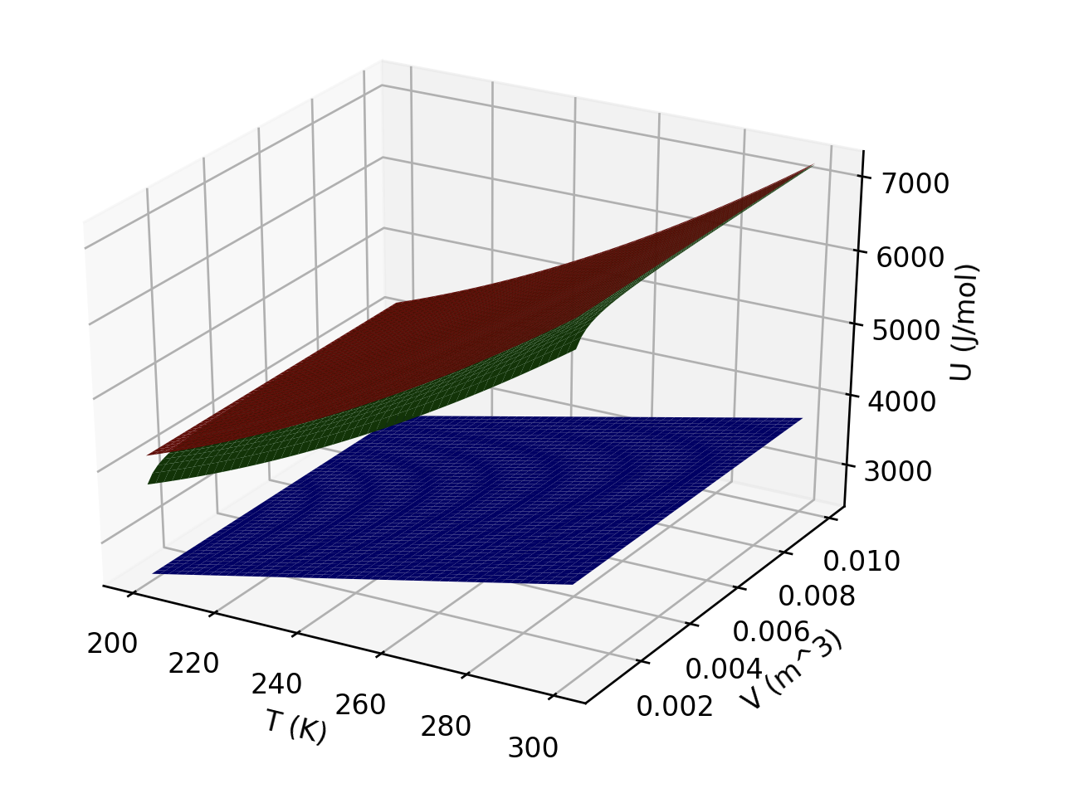
Interpreting U(T,V)
Which of these three gases could be ideal?
Which could be a monatomic gas?

Slide 2
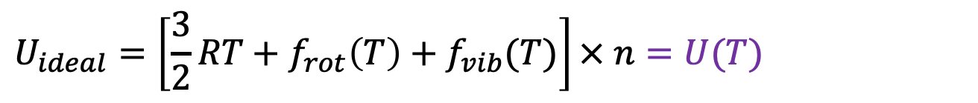
Interpreting U(T,V)
Ideal gas molecules don’t see each other. That means there can’t be any volume dependence of the internal energy on volume:
$$U_{ideal}=\left[\frac{3}{2}RT+f_{rot}\left(T\right)+f_{vib}(T)\right]× n=U(T)$$
In contrast, real gases have intermolecular interactions. These interactions are increasingly prominent at low volume (so obviously, $U_{real}$is volume-dependent):
$$U_{real}=\left[\frac{3}{2}RT+f_{rot}\left(T\right)+f_{vib}\left(T\right)+f_{intermol}(T,V)\right]× n=U(T,V)$$
Translational and rotational parts of the internal energy are linear functions of $T$ (like $\frac{3}{2}RT$), but vibrational contributions tend to be nonlinear functions of $T$ (i.e., curved).

Slide 3
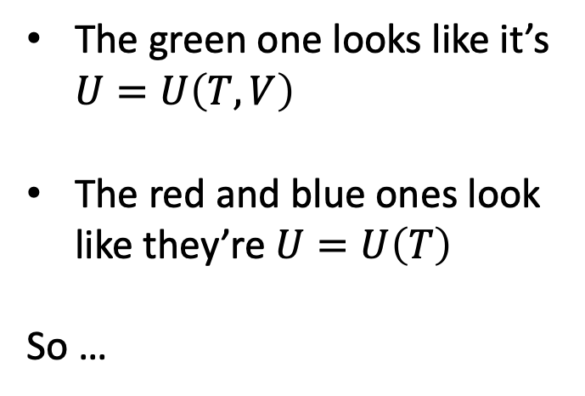
Interpreting U(T,V)
The green one looks like it’s $U=U\left(T,V\right)$
The red and blue ones look like they’re $U=U\left(T\right)$
So …

Slide 4
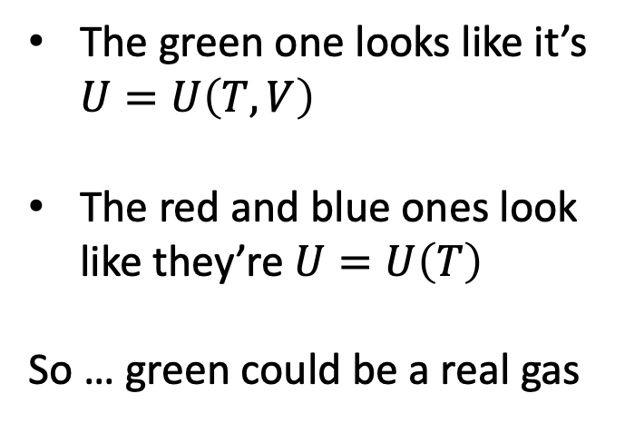
Interpreting U(T,V)
The green one looks like it’s $U=U\left(T,V\right)$
The red and blue ones look like they’re $U=U\left(T\right)$
So … green could be a real gas

Slide 5
